Slide 1
Operating System Fundamentals
Computer Engineering
Notes:
Introduction to the presentation on Operating System Fundamentals.

Slide 2
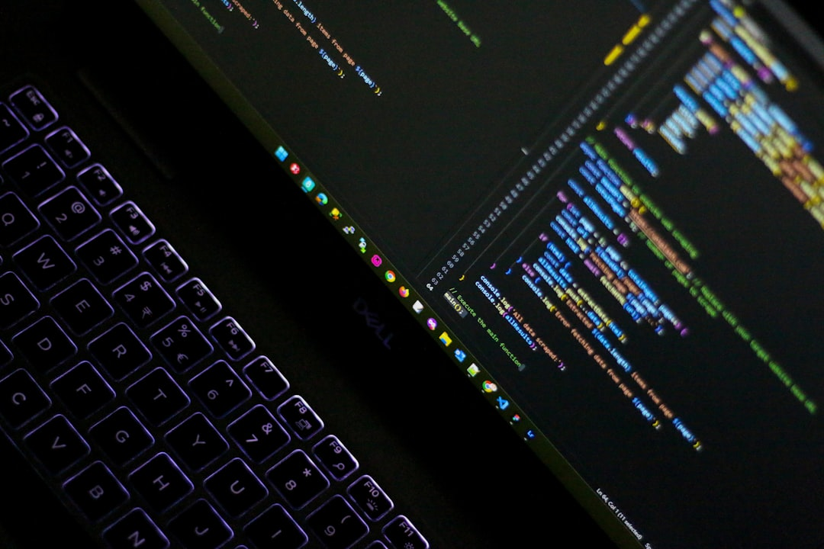
Introduction
Operating Systems manage computer hardware and software resources efficiently and effectively always.
Introduction to Operating Systems includes understanding basic concepts and terminology clearly.
Computer hardware interacts with Operating Systems to perform specific tasks and functions.
Operating Systems provide a platform for running application software and utilities smoothly.
Basic functions of Operating Systems include process management and memory allocation always.
Operating Systems control input output devices and manage file systems securely.
Introduction to Operating Systems involves understanding system configuration and installation procedures.
Operating Systems provide security features and utilities for user authentication and authorization.
Fundamentals of Operating Systems include understanding network communication protocols and interfaces.
Operating Systems support various programming languages and software development tools always.
Notes:
Explain Introduction in the context of Operating System Fundamentals.

Slide 3

Core Concept / Architecture
Operating System manages computer hardware and software resources efficiently always
Core concept includes process management and synchronization techniques always
Architecture comprises kernel space and user space interactions primarily
Device management involves handling input output operations effectively always
Memory management enables efficient allocation and deallocation always
File system management provides data storage and retrieval mechanisms
Security and authentication ensure authorized access to system resources
Interrupt handling enables asynchronous event processing and management
Multitasking and multithreading enhance system performance and responsiveness
Notes:
Explain Core Concept / Architecture in the context of Operating System Fundamentals.

Slide 4
Mathematical / Logical Explanation
Algorithms and data structures form the basis of operating system design and development processes always
Mathematical modeling helps in predicting system performance and behavior under various workload conditions effectively
Logical explanations of complex system interactions enable better understanding and analysis of operating systems
Discrete mathematics and graph theory are essential for understanding process scheduling and memory management
Operating system security relies heavily on mathematical concepts like cryptography and encryption techniques always
Formal language theory and automata theory are used to design and verify operating system protocols
Probability and statistics are applied to analyze and optimize system performance and resource allocation
Boolean algebra and logic gates are fundamental to the design of digital circuits and computer architecture
Mathematical proof techniques are used to verify the correctness and reliability of operating system components
Logical reasoning and problem-solving skills are essential for troubleshooting and debugging operating system issues
Notes:
Explain Mathematical / Logical Explanation in the context of Operating System Fundamentals.

Slide 5
Applications / Use Cases
Embedded systems utilize operating systems for managing hardware resources efficiently always
Real-time operating systems are used in critical applications requiring precise timing control
Mobile operating systems provide a platform for developing various mobile applications quickly
Desktop operating systems offer a graphical user interface for easy user interaction always
Server operating systems manage multiple user accounts and provide network security features
Mainframe operating systems support large-scale enterprise applications with high reliability
Operating systems enable virtualization for efficient resource allocation and utilization always
Gaming consoles rely on specialized operating systems for optimal performance and graphics rendering
Automotive operating systems control various vehicle functions such as navigation and entertainment systems
Notes:
Explain Applications / Use Cases in the context of Operating System Fundamentals.

Slide 6
Summary & Key Takeaways
Operating systems manage computer hardware resources efficiently and effectively always
Process management is a critical component of operating system design and development always
Memory management enables efficient use of main memory and storage devices always
File systems provide a hierarchical structure for storing and retrieving data files
Input output management handles data transfer between devices and the operating system
Security features protect the operating system and user data from unauthorized access
Interrupt handling enables the operating system to respond to hardware interrupts quickly
Device drivers interact with hardware devices to perform specific tasks and functions
Networking capabilities enable communication between computers and devices on a network
Operating system configuration and customization options meet specific user needs
Notes:
Explain Summary & Key Takeaways in the context of Operating System Fundamentals.

